Slide 1
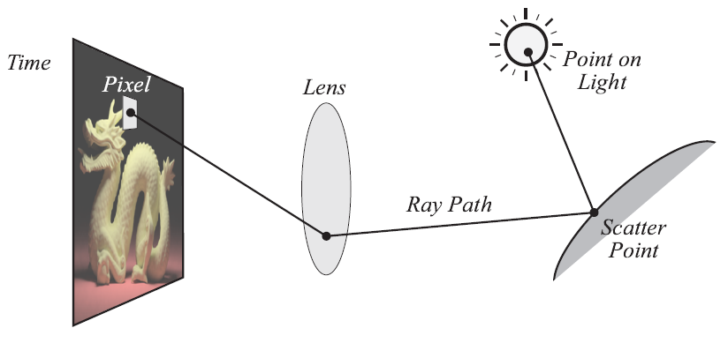
How to form a GI image?

Slide 2
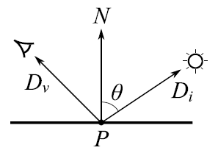
The Rendering Equation

Slide 3
The Rendering Equation
The radiance (intensity of light)
Coming from surface point P
In direction D_{v.} This is what we
Have to calculate.

Slide 4
The Rendering Equation
The self-emitted radiance from P
In direction D_{v} (0 unless point P
Is a light source) This can be looked
Up as part of the scene description.

Slide 5
The Rendering Equation
The reflected light term. Here we must add
Up (integrate) all of the light coming in to
point P from all directions, modulated by the
Chance that it scatters in direction D_{v}
(based on the BRDF function, F_{s})

Slide 6

Path Tracing Approximation
Replace the ray integral with a Monte Carlo
(random) Sample that has the same Expected
(average) Value. Then average a bunch of
samples for each pixel to create a smooth image.

Slide 7
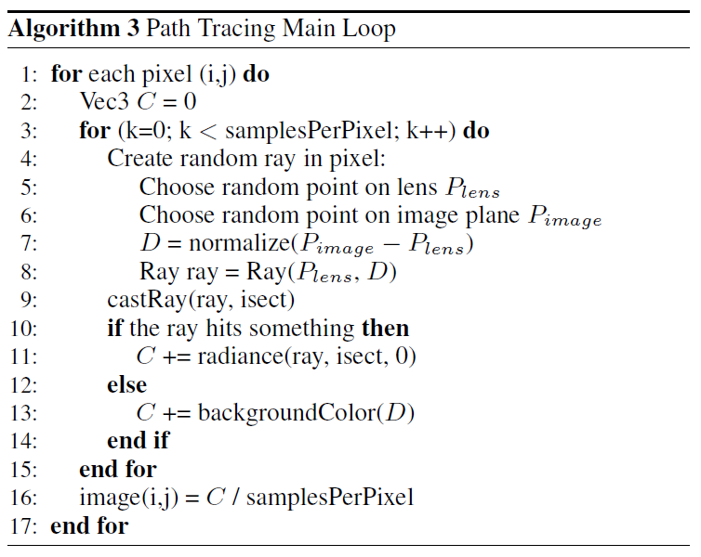
Path Tracing Algorithm

Slide 8
Camera Setup
cy
gaze
direction
cx
look
from

Slide 9
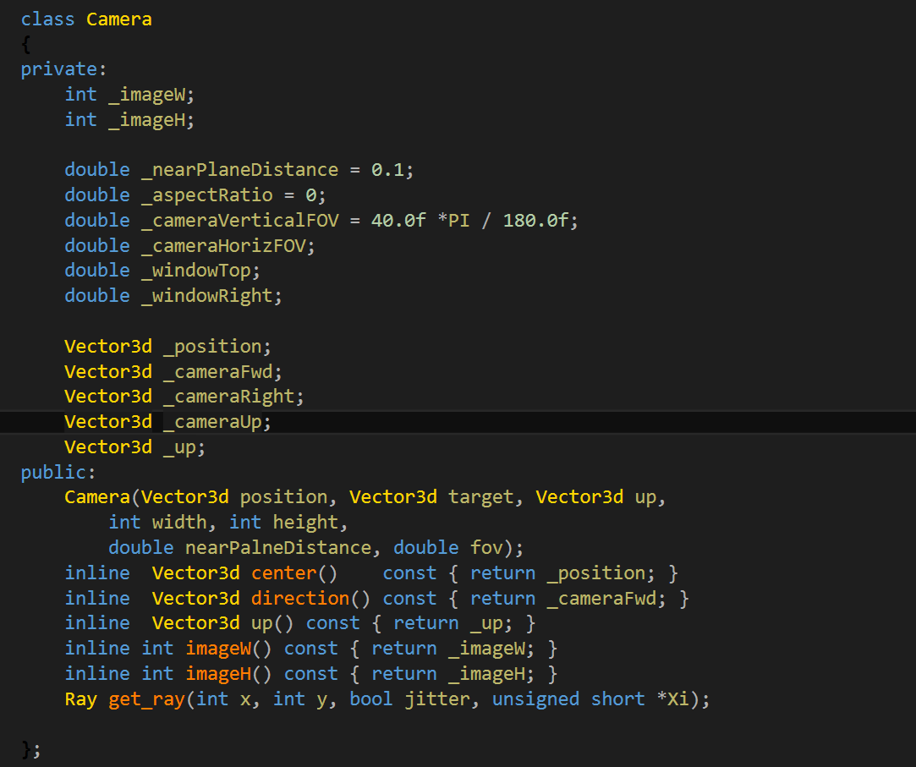
Camera class

Slide 10
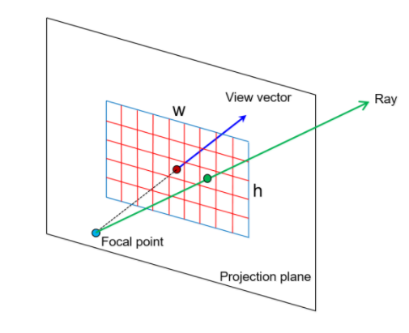
Camera generate ray
float imageAspectRatio = imageWidth / (float)imageHeight; // assuming width > height
float Px = _cameraRight *(2 * ((x + 0.5) / imageWidth) - 1) * tan(fov / 2 * M_PI / 180) *nearPlaneDistance;
float Py = cameraUp*(1 - 2 * ((y + 0.5) / imageHeight) * tan(fov / 2 * imageAspectRatio * M_PI / 180) *nearPlaneDistance;
Vec3f rayDirection = Vec3f(Px, Py,rayOrigin+_nearPlaneDistance*_cameraFwd) - rayOrigin;
// note that this just equal to Vec3f(Px, Py, -1);
rayDirection = normalize(rayDirection); // it's a direction so don't forget to normalize

Slide 11
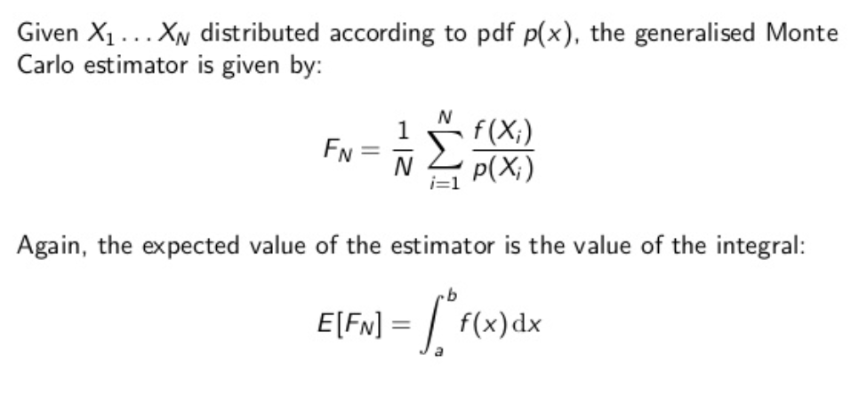

Slide 12
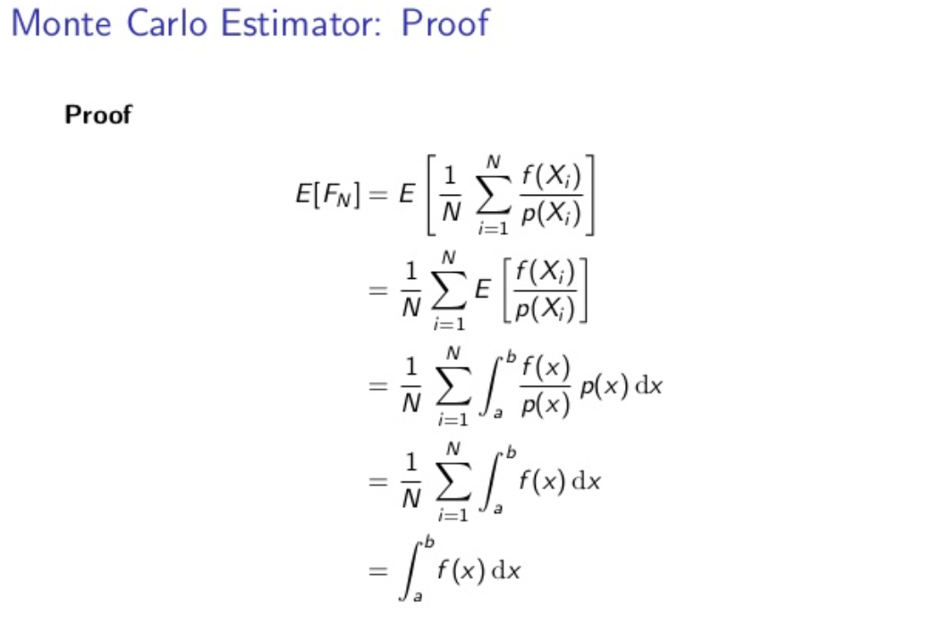

Slide 13
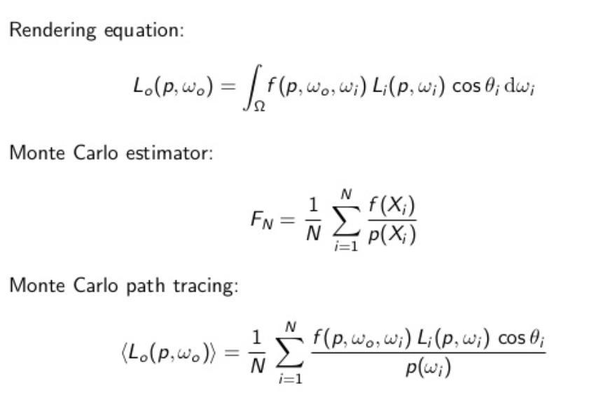

Slide 14
